Slide 1
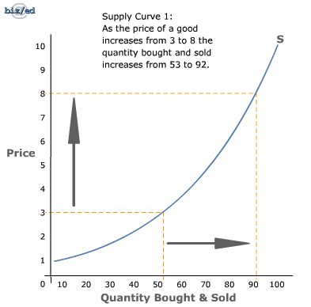
Chapter 5 - Supply

Slide 2
Chapter 5
Supply – the amount of a product that would be offered for sale at all possible prices that could prevail in the market
Law of Supply – the principle that suppliers will normally offer more for sale at high prices and less at lower prices

Slide 3
Chapter 5

Slide 4
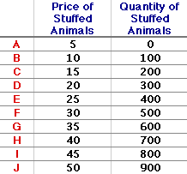
Chapter 5
Supply Schedule – a listing of various quantities of a particular product supplied at all possible prices in the market
Supply Curve – a graph showing the various quantities supplied at each and every price that might prevail in the market

Slide 5
Chapter 5
Market Supply Curve – the supply curve that shows the quantities offered at various prices by all firms that offer the product for sale in a given market
Quantity Supplied – The amount that producers bring to market at any given price
Change in Quantity Supplied – The change in amount offered for sale in response to a change in price
Movement ALONG the supply curve
Show example

Slide 7
Warm Up
What is the economic definition of “Elasticity”
What does “Inelastic” mean?
Would a “Want” most likely be elastic or inelastic? How about a “Need”?
See the board and identify the “Elastic” line and the “Inelastic” line
What does “Unit Elastic” mean?
What are the two factors that cause movement ALONG the demand curve?
What are the five factors that cause the demand curve to shift?
How much money did Yahoo lose last quarter? According to speculation, how much is Yahoo worth today?
Notes:
4.43 billion

Slide 8
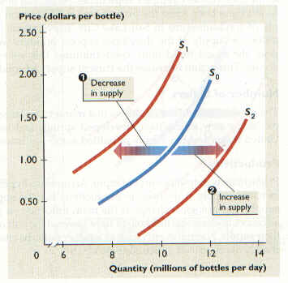
Chapter 5
Change in Supply – a situation where suppliers offer different amounts of products for sale at all possible prices in the market
A SHIFT of the Curve
Show Example

Slide 9
Warm Up #3
Who ultimately decides the demand curve? Supply curve?
See the board and graph the supply and demand schedules. What is the equilibrium point? Name at least TWO possibilities that would have moved the demand curve. Name TWO possibilities that would have moved the supply curve.
Draw an INELASTIC graph, UNIT ELASTIC graph, ELASTIC graph
What is the difference between a change in quantity supplied vs a change in supply?

Slide 10
Warm Up #9
See the board and graph the supply and demand schedules. What is the equilibrium point? Name at least TWO possibilities that would have moved the demand curve. Name TWO possibilities that would have moved the supply curve.
Draw an INELASTIC graph, UNIT ELASTIC graph, ELASTIC graph
CEQ: Apple is having another product release this week. What are they expected to announce?
CEQ #2: Who’s celebrating their 18th birthday today?

Slide 11
Chapter 5
Things that SHIFT the supply curve
Cost of Inputs
If it costs more to produce an item the curve shifts to the LEFT
If it costs less then the curve shifts to the RIGHT
Productivity
If workers become more productive the curve shifts to the RIGHT (ex. Motivation)
If workers are less productive the curve shifts to the LEFT
Technology
New technology (if effective) will shift the curve to the RIGHT
New technology (if ineffective) will shift the curve to the LEFT

Slide 12
Chapter 5
Things that SHIFT the supply curve
Taxes and Subsidies
Taxes are added costs to companies – SHIFTS the supply curve to the LEFT
Subsidies are beneficial to companies – SHIFTS the supply curve to the RIGHT
Expectations
If producers think the price of their product will go up, they may withhold some of the supply (SHIFTS supply curve to the LEFT
Producers may expect lower prices in the future so they try to sell as much as possible at a higher price (SHIFTS supply curve to the RIGHT)

Slide 13
Chapter 5
Things that SHIFT the supply curve
Government Regulations
More government regulations SHIFT the supply curve to the LEFT
Less government regulation SHIFT the supply curve to the RIGHT
Number of Sellers
As more firms enter the industry supply goes up and the supply curve SHIFTS to the RIGHT
If firms leave the industry there is less supply which SHIFTS the supply curve to the LEFT

Slide 15
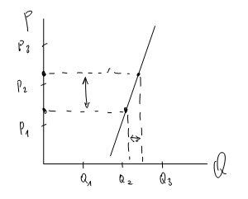
Chapter 5
Supply Elasticity – a measure of the way in which quantity supplied responds to a change in price
3 Types of supply elasticity
Elastic Supply, Inelastic Supply, Unit Elastic Supply
Show examples

Slide 16
Warm Up
What are the 7 things that shift the supply curve?
Draw the supply curve shifts of the following scenarios. Make sure to label all parts of the graph.
The technology has made it cheaper to produce cars
Workers become less motivated because of a mean boss
More people start to make widgets
The price of putting sugar in Pepsi goes down
The government adds a tax to the sale of alcohol
Apple predicts that in 6 months the price of the IPhone will go down

Slide 17
Chapter 5
Theory of Production – the relationship between the factors of production and the output of goods and services
Short Run – a period of production that allows producers to change only the amount of the variable input of production
Ex) Ford hires 300 new workers
Long Run – a period of production long enough for producers to adjust the quantities of all their resources, including capital.
Ex) Ford builds a new factory

Slide 18
Chapter 5
Law of Variable Proportions – States that in the short run, output will change as one input is varied while the others are held constant
Ex) Salt in food – A little makes it taste better – too much makes it taste bad
Production Function – A concept that describes the relationship between changes in output to different amounts of a single input while other inputs are held constant
Raw Materials – Unprocessed natural products used in production

Slide 19
Warm UP #11
What are the six factors that SHIFT the DEMAND curve?
What are the seven factors that SHIFT the SUPPLY curve?
What is the equilibrium price?
See the board for the new supply and demand schedule. Graph and label ENTIRELY.

Slide 20
Chapter 5
Total Product – Total output
Marginal Product – The extra output or change in total product caused by the addition of one more unit of variable input
Stages of Production – Increasing returns, diminishing returns, and negative returns that are based on the way marginal product changes as the variable input of labor is changed

Slide 21
Chapter 5
Diminishing Returns – The stage where output increases at a diminishing rate as more units of a variable input are added
Fixed Cost – The cost that a business incurs even if the plant is idle and output is zero
Overhead – Total Fixed Cost
Variable Cost – A cost that changes when the business rate of operation or output changes
Total Cost – Sum of the fixed and variable costs

Slide 22
Chapter 5
Marginal Cost – The extra cost incurred when a business produces one additional unit of a product
E-Commerce – Electronic business or exchange conducted over the internet
Total Revenue – The number of units sold multiplied by the average price per unit
Marginal Revenue – The extra revenue associated with the production and sale of one additional unit of output

Slide 23
Chapter 5
Marginal Analysis – A type of cost-benefit decision making that compares the extra benefits to the extra costs of an action
Break-Even Point – The total output a business needs to sell in order to break even
Profit-Maximizing quantity of output – When marginal cost and marginal revenue are even

Slide 24
All Content Created by DJ Cook

